Slide 1
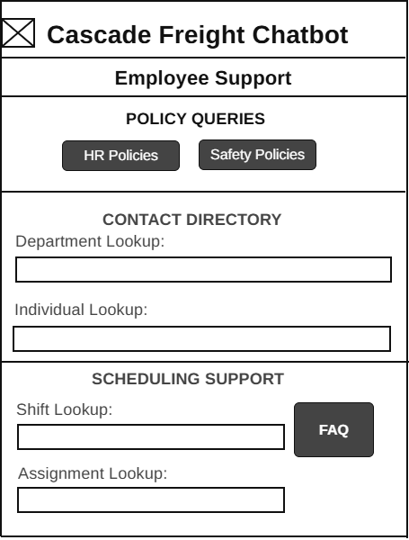
Cascade Freight Systems Chatbot
User Account Administration
User Story – 4.0 Employee Support
As an employee, I want to search for department and individual contact information so I can quickly reach the right person or team for support.
Development Tasks
Integrate chatbot with HR and safety policy repositories
Implement NLP intent recognition for policy queries
Create standardized response templates with fallback answers
Apply role‑based access controls and audit logging
Conduct unit, edge case, and user acceptance testing

Slide 2
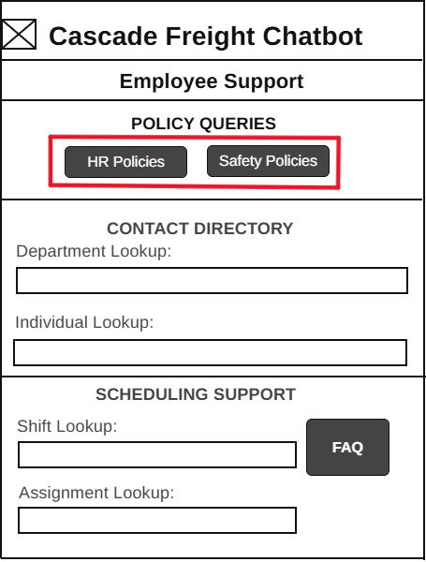
Cascade Freight Systems Chatbot
User Account Administration
User Story – 4.1 Policy Queries
As an employee, I want to query safety policies (freight handling, compliance rules) through the chatbot so that I can follow company procedures correctly and stay compliant.
Development Tasks
Integrate chatbot with HR and safety policy repositories.
Implement NLP intent recognition for HR vs. safety queries.
Create standardized response templates with fallback answers.
Apply role‑based access controls and audit logging.
Conduct unit, edge case, and user acceptance testing.

Slide 3
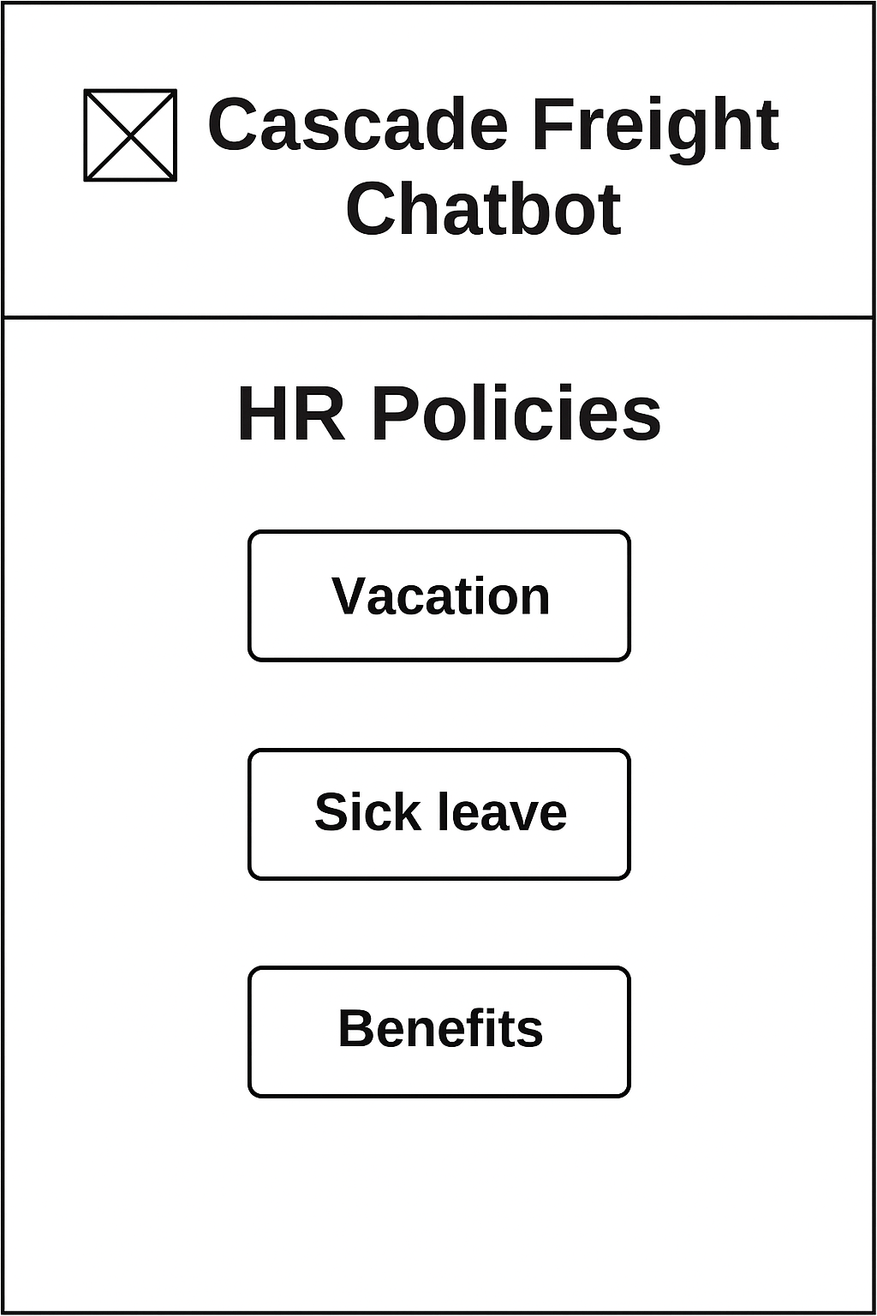
Cascade Freight Systems Chatbot
User Account Administration
User Story – 4.1.1 HR Policies
As an employee, I want to query HR policies such as vacation, sick leave, and benefits so that I can plan my time off and understand my entitlements without needing to contact HR staff directly.
Development Tasks
Build a dedicated HR Policies interface panel triggered by the “HR Policies” button.
Connect chatbot to internal HR documentation covering vacation, sick leave, and benefits.
Implement NLP to classify and route queries to relevant HR policy sections.
Design response templates for each HR topic with links to full policy documents.
Log all HR policy queries with timestamps and user IDs for audit compliance.

Slide 4
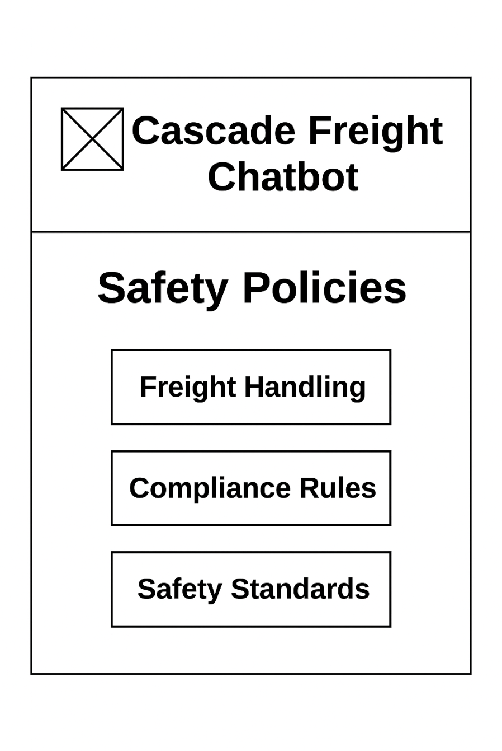
Cascade Freight Systems Chatbot
User Account Administration
User Story – 4.1.2 Safety Policies
As an employee, I want to query safety policies through the chatbot so that I can receive guidance on freight handling procedures, compliance rules, and workplace safety standards to ensure I perform my job safely and in accordance with company regulations.
Development Tasks
Build a dedicated Safety Policies panel triggered by the “Safety Policies” button.
Connect chatbot to internal safety documentation covering freight handling, compliance rules, and workplace safety standards.
Implement NLP classification to detect queries related to freight handling, compliance, or general workplace safety.
Create response templates that provide clear guidance and link to full safety documents.
Apply role‑based access controls and log all safety policy queries for compliance and audit purposes.

Slide 5
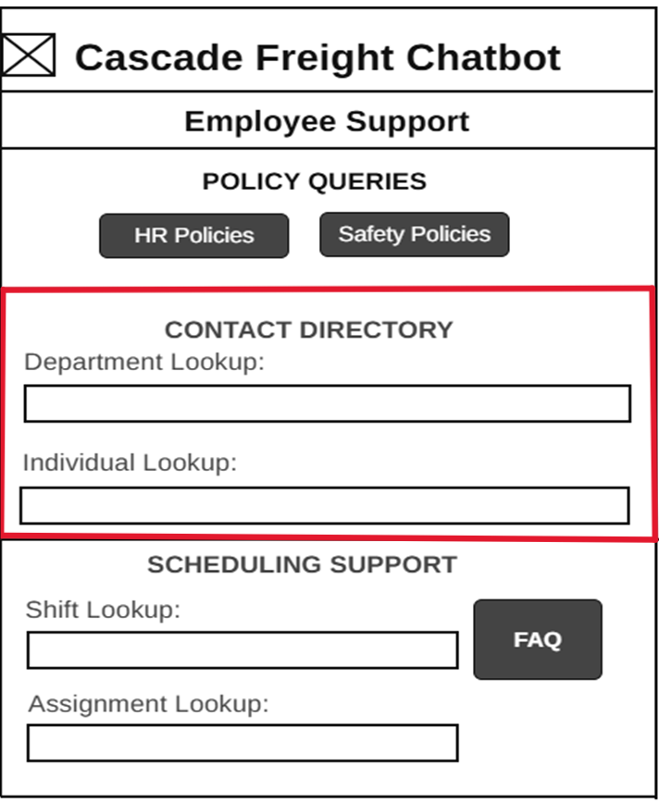
Cascade Freight Systems Chatbot
User Account Administration
User Story – 4.2 Contact Directory
As an employee, I want to search for department and individual contact information so I can quickly reach the right person or team for support.
Development Tasks
Build Department Lookup and Individual Lookup input fields connected to the internal directory database.
Format chatbot responses to display phone/email details in a clear, structured card layout.
Enforce role-based access control to ensure only authorized staff can view contact information.
Implement error handling for invalid or missing queries, with “No results found” messaging.
Log all lookup queries for audit and compliance, and test with sample departments and employee records.

Slide 6
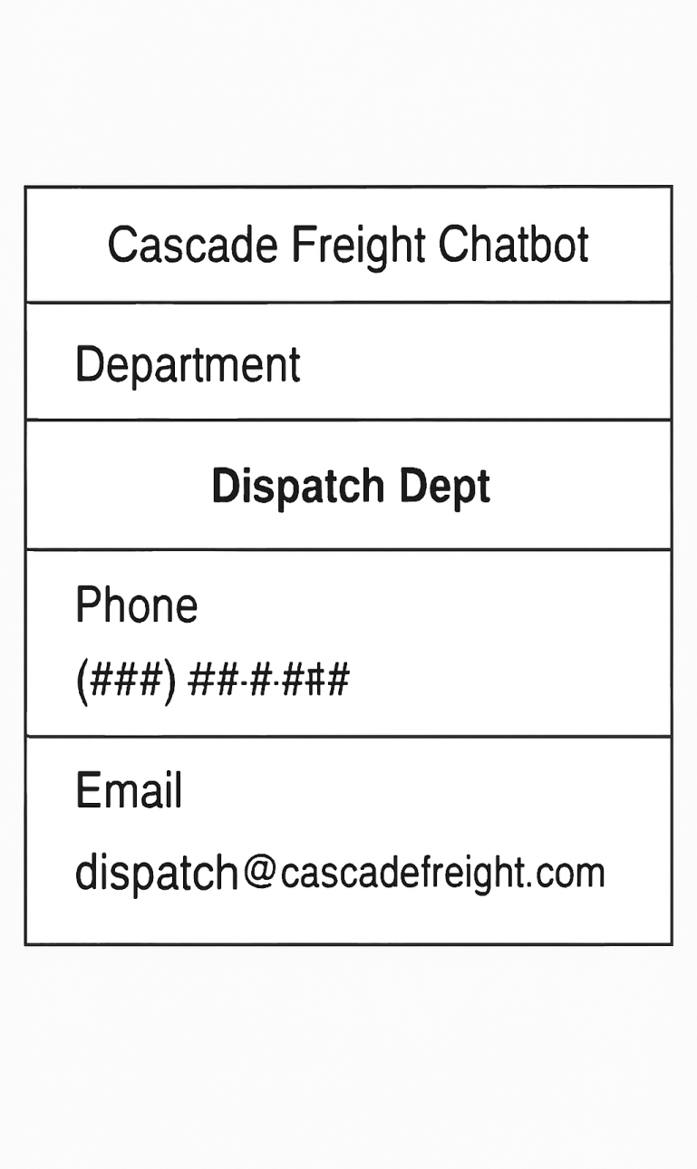
Cascade Freight Systems Chatbot
User Account Administration
User Story – 4.2.1 Department Lookup
As an employee, I want to search for a department and retrieve its contact information so I can quickly reach the right team for support.
Development Tasks
Implement search input field for department names connected to the internal directory database.
Build query logic to return department name, phone number, and email address.
Format chatbot responses into a structured pane with clear labels.
Add error handling for invalid or missing department queries.
Log all lookup queries for audit and compliance purposes.

Slide 7
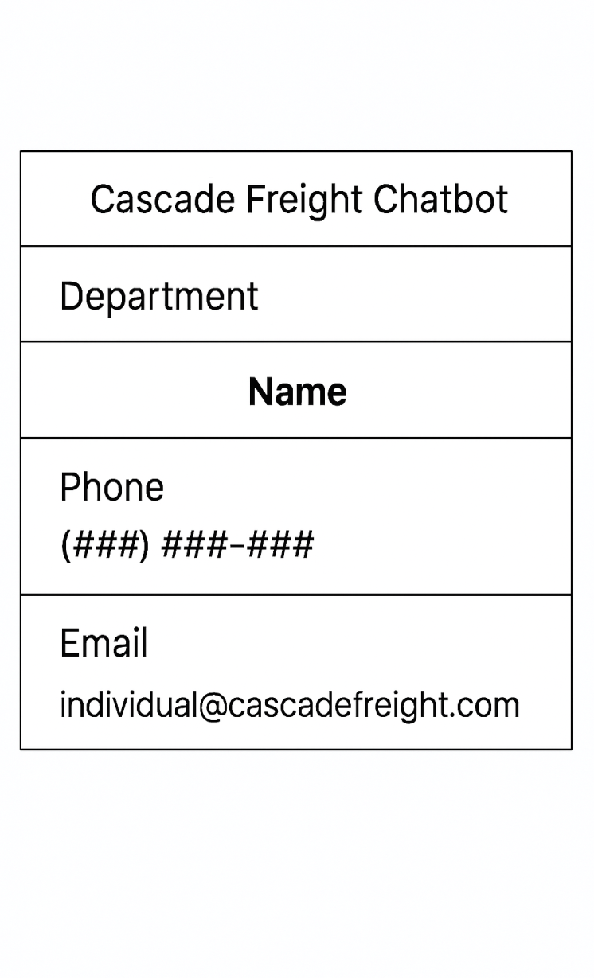
Cascade Freight Systems Chatbot
User Account Administration
User Story – 4.2.2 Individual Lookup
As an employee, I want to search for a specific individual’s contact information so I can directly reach the person I need for support or coordination.
Development Tasks
Implement search input field for employee names connected to the internal directory database.
Build query logic to return individual’s name, phone number, and email address.
Format chatbot responses into a structured pane with clear labels for contact details.
Add error handling for invalid or missing employee queries (e.g., “No results found”).
Log all lookup queries for audit and compliance, and test with sample employee records.

Slide 8
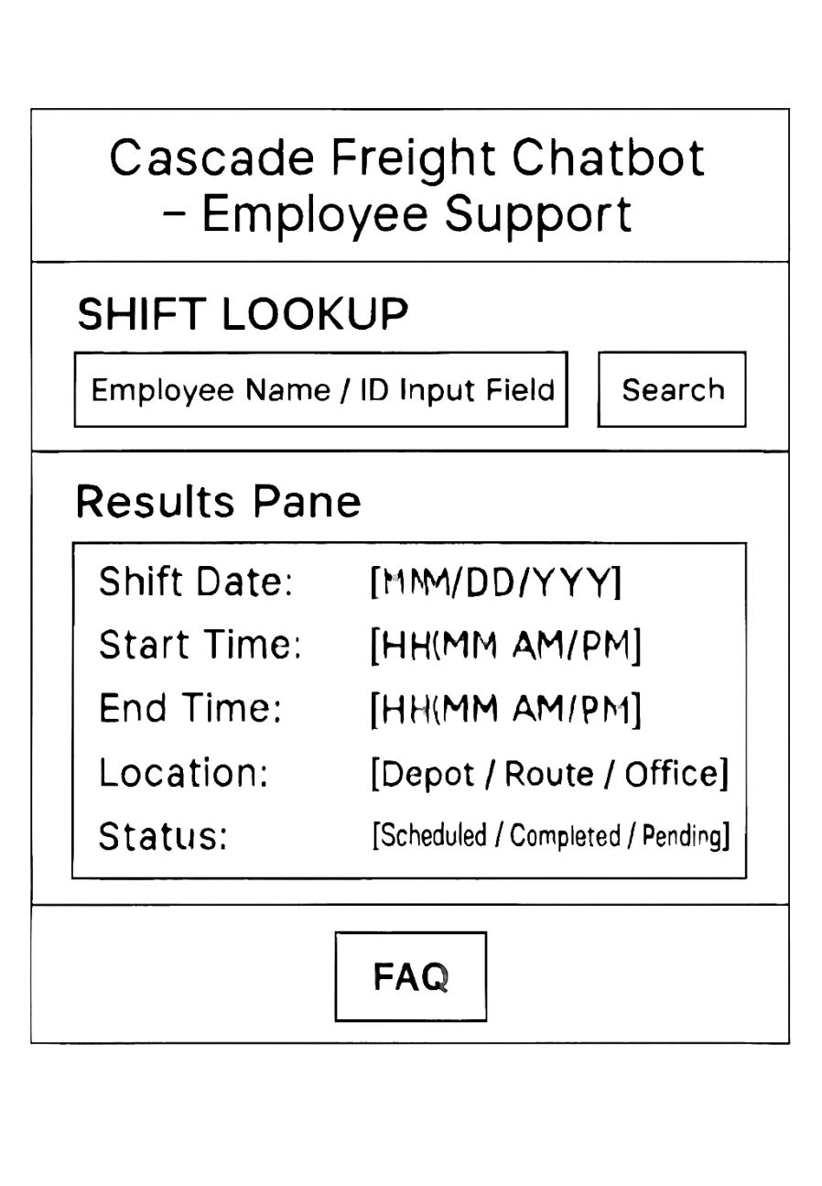
Cascade Freight Systems Chatbot
User Account Administration
User Story – 4.3 Shift lookup
As an employee, I want to look up my upcoming shifts so I can plan my schedule and ensure I’m prepared for my assignments.
Development Tasks
Implement Shift Lookup input field connected to the internal scheduling database.
Build query logic to return upcoming shifts with date, time, and assignment details.
Format chatbot responses into a structured pane showing shift information clearly.
Add error handling for invalid or missing shift queries (e.g., “No shifts found”).
Log all shift lookup queries for audit and compliance, and test with sample employee schedules.

Slide 9
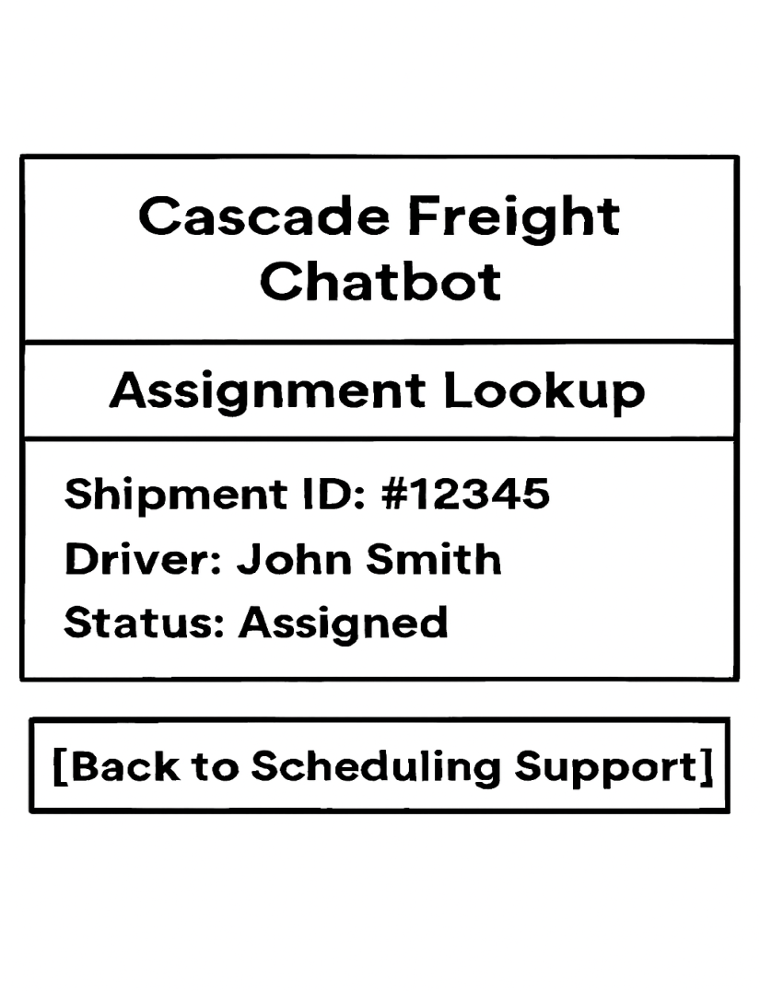
Cascade Freight Systems Chatbot
User Account Administration
User Story – 4.3 Shift lookup
As an employee, I want to look up my upcoming assignments so that I can quickly see which shipments I am responsible for and plan my schedule accordingly.
Development Tasks
Implement database queries to fetch driver–shipment assignment data.
Enforce role‑based access control for dispatcher, driver, and support staff views.
Design and build the Assignment Lookup UI panel (search + results table).
Integrate audit logging for all lookup queries and results.
Add error handling and clear feedback for invalid or restricted queries.

Slide 10
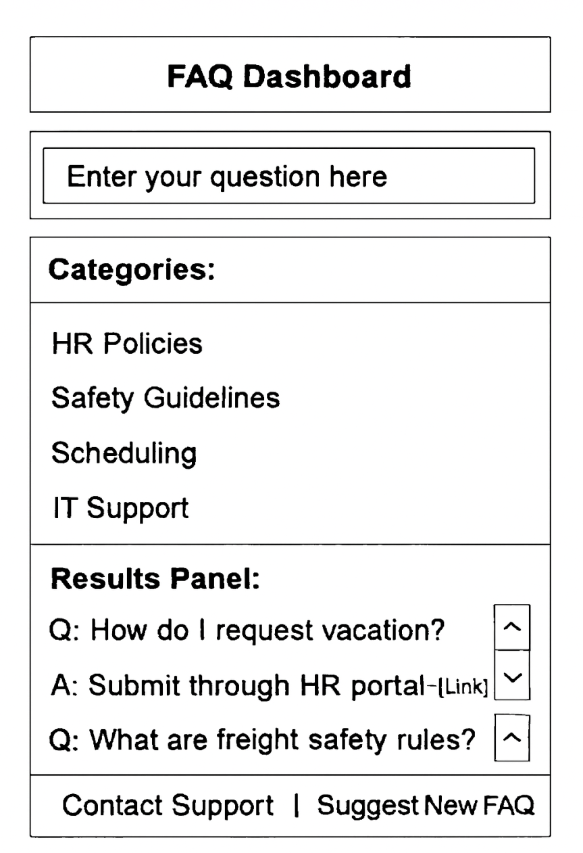
Cascade Freight Systems Chatbot
User Account Administration
User Story – 4.3 FAQ Responses
As an employee, I want to access quick FAQ responses so that I can resolve common questions (e.g., HR policies, scheduling, safety rules) without needing to contact support staff.
Development Tasks
Implement FAQ database with categorized questions and answers
Build search functionality to match employee queries with relevant FAQ entries
Design FAQ UI panel with expandable/collapsible answers
Integrate role‑based access (support staff can update FAQs, employees can only view)
Add audit logging for FAQ queries and updates

